Slide 1
Capstone Project
Shop For Home
java+Gcp_C3
Group no_05 by- R LIKHITHA
k Navya
J MANEESHA
DEEPA

Slide 2
Introduction
ShopFromHome is a web application for shopping the home decor stuff such as dinning tables,hanging light ,groceries and other home decoration are available .Online shops give us the opportunity to shop 24/7, and also reward us with a ‘no pollution’ shopping experience.
Online shopping can save time for both the buyer and retailer, reducing phone calls about availability, specifications, hours of operation or other information easily found on company and product pages.

Slide 3
Technologies and tools used
TECHNOLOGIES:
Front-End: HTML, CSS, JAVASCRIPT, ANGULAR
Back-End: SPRINGBOOT, postgreSQL
TOOLS:
Front-End : Visual Studio Code
Back-End : STS4(Spring Tool Suite 4), MySQL Workbench 8.0CE
Browser : Google Chrome For Development
Database : postgreSQL

Slide 4
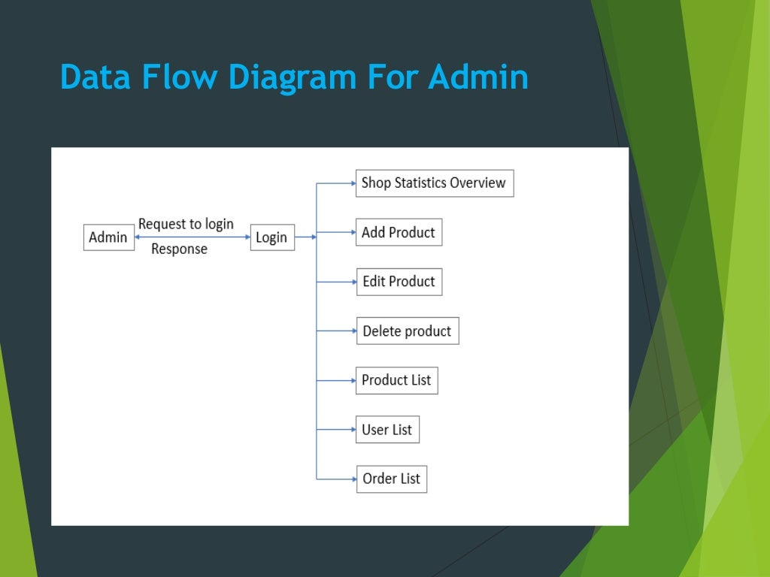
DATA FLOW DIAGRAM FOR ADMIN

Slide 5
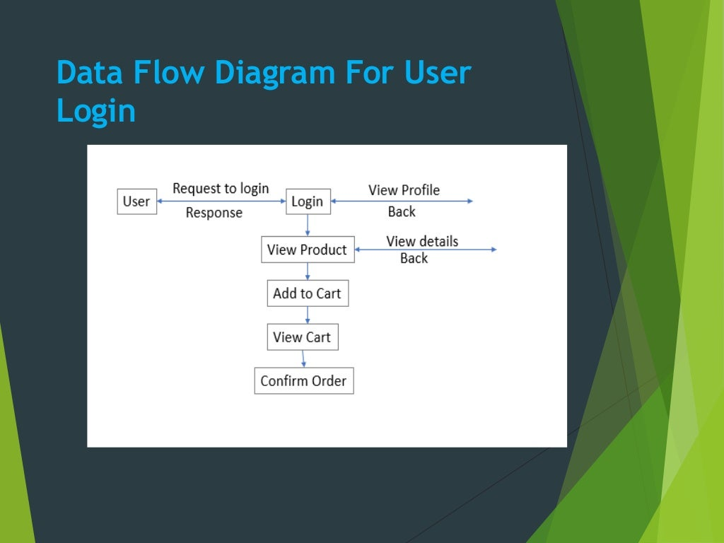
DATA FLOW DIAGRAM FOR USER LOGIN

Slide 6
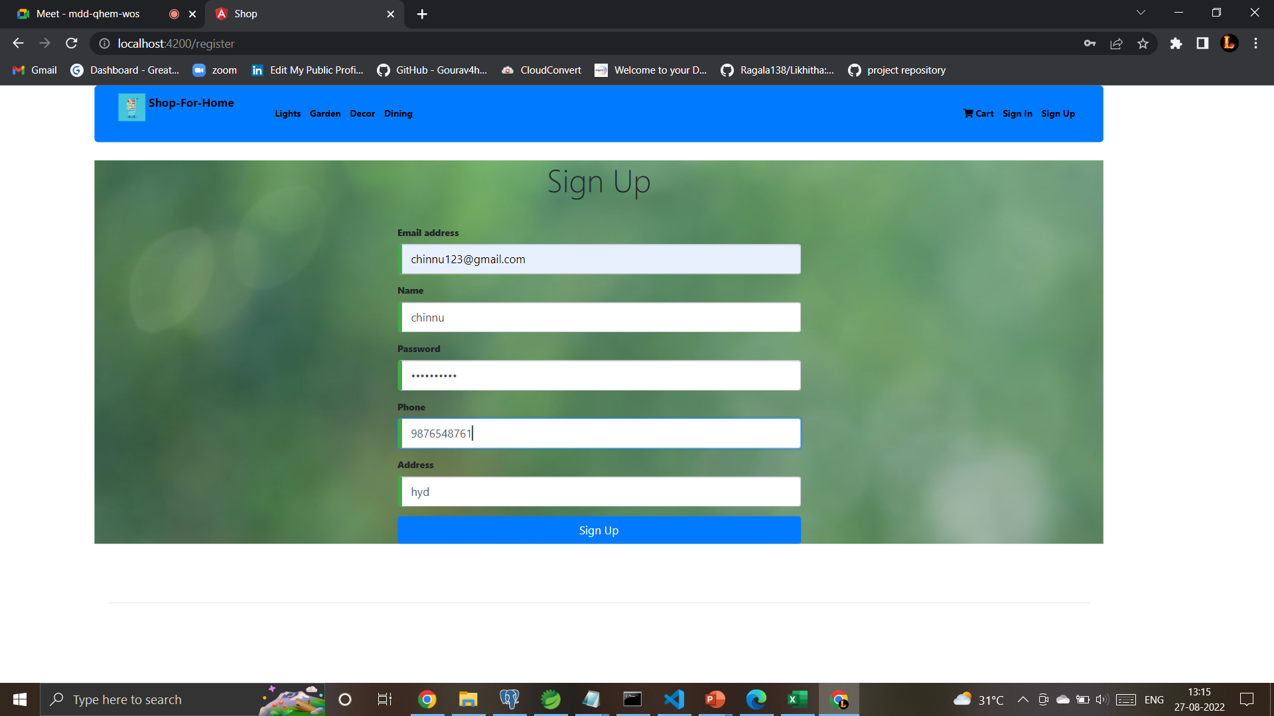
SIGN UP PAGE

Slide 7
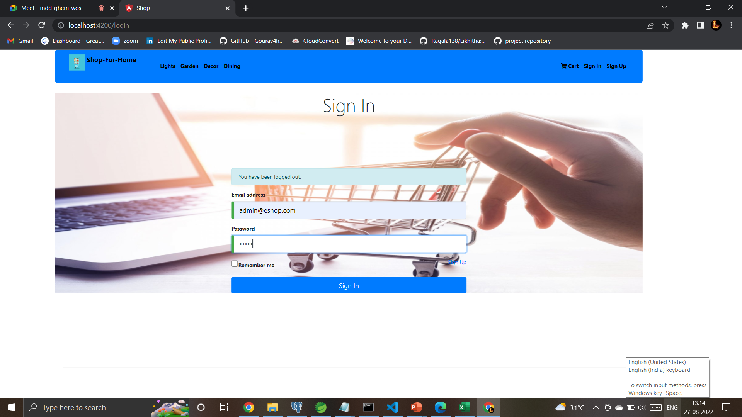
Login page

Slide 8
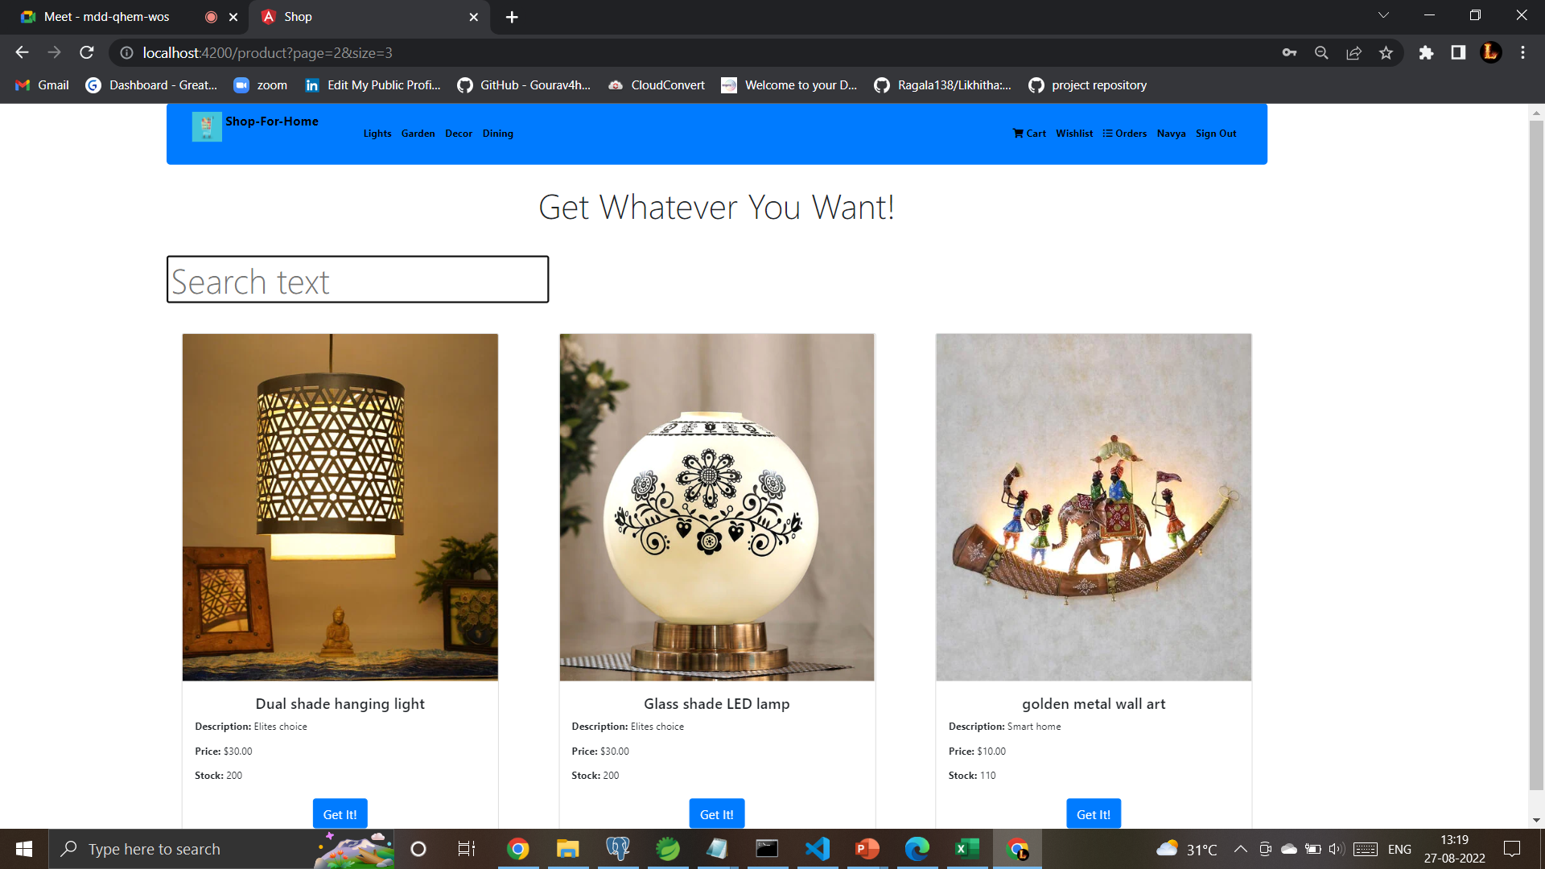
Home page

Slide 9
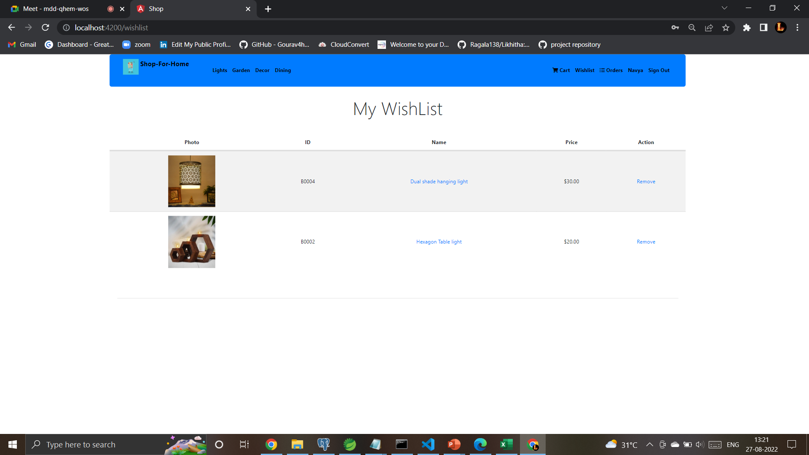
Wish list

Slide 10
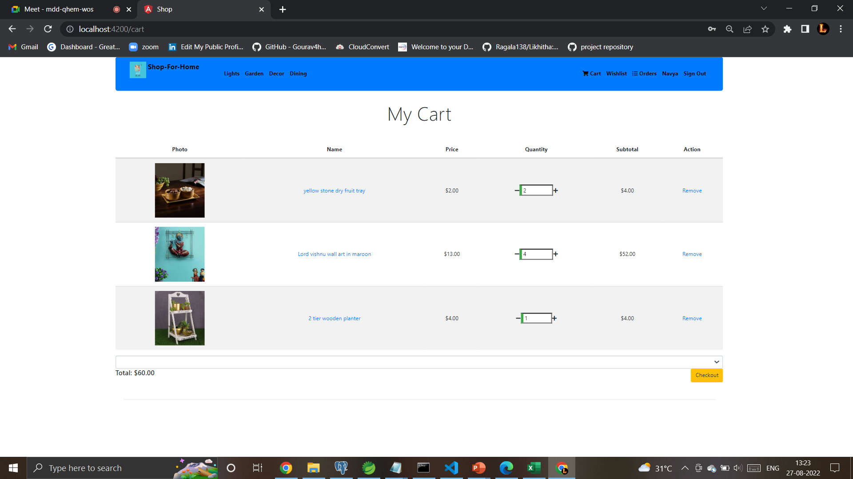
my Cart

Slide 11
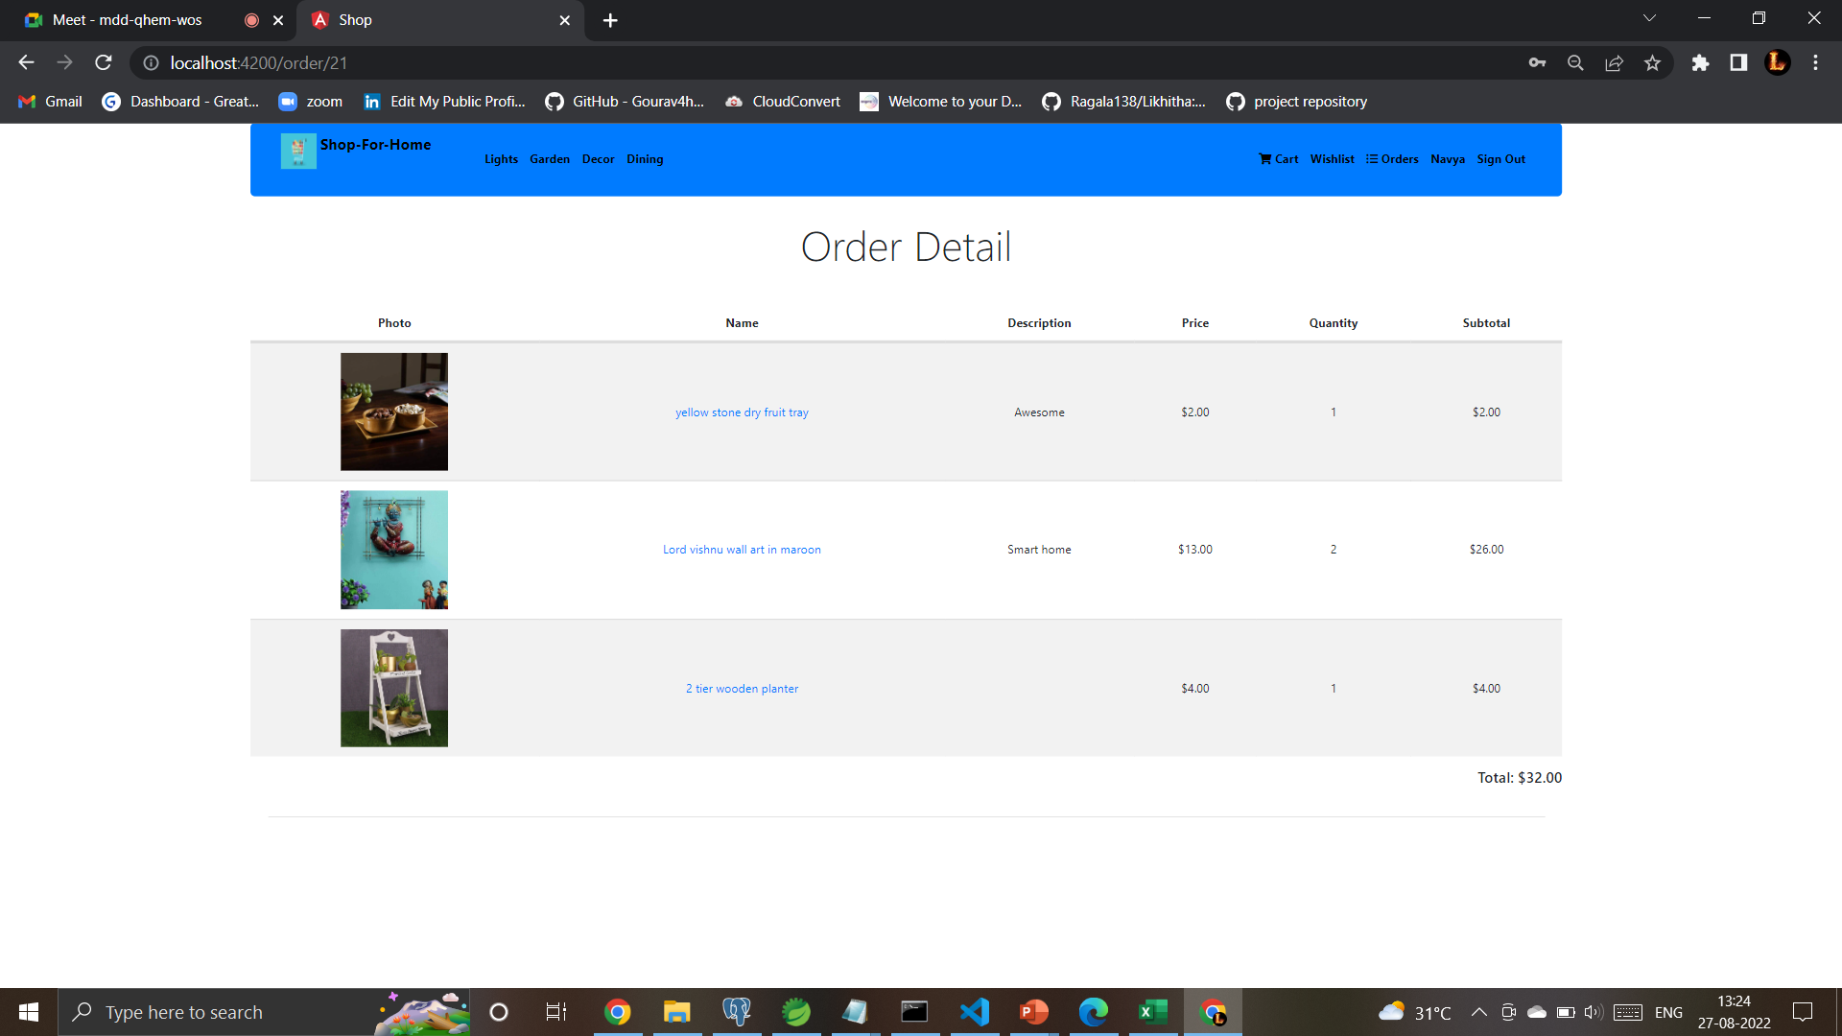
Orders

Slide 12
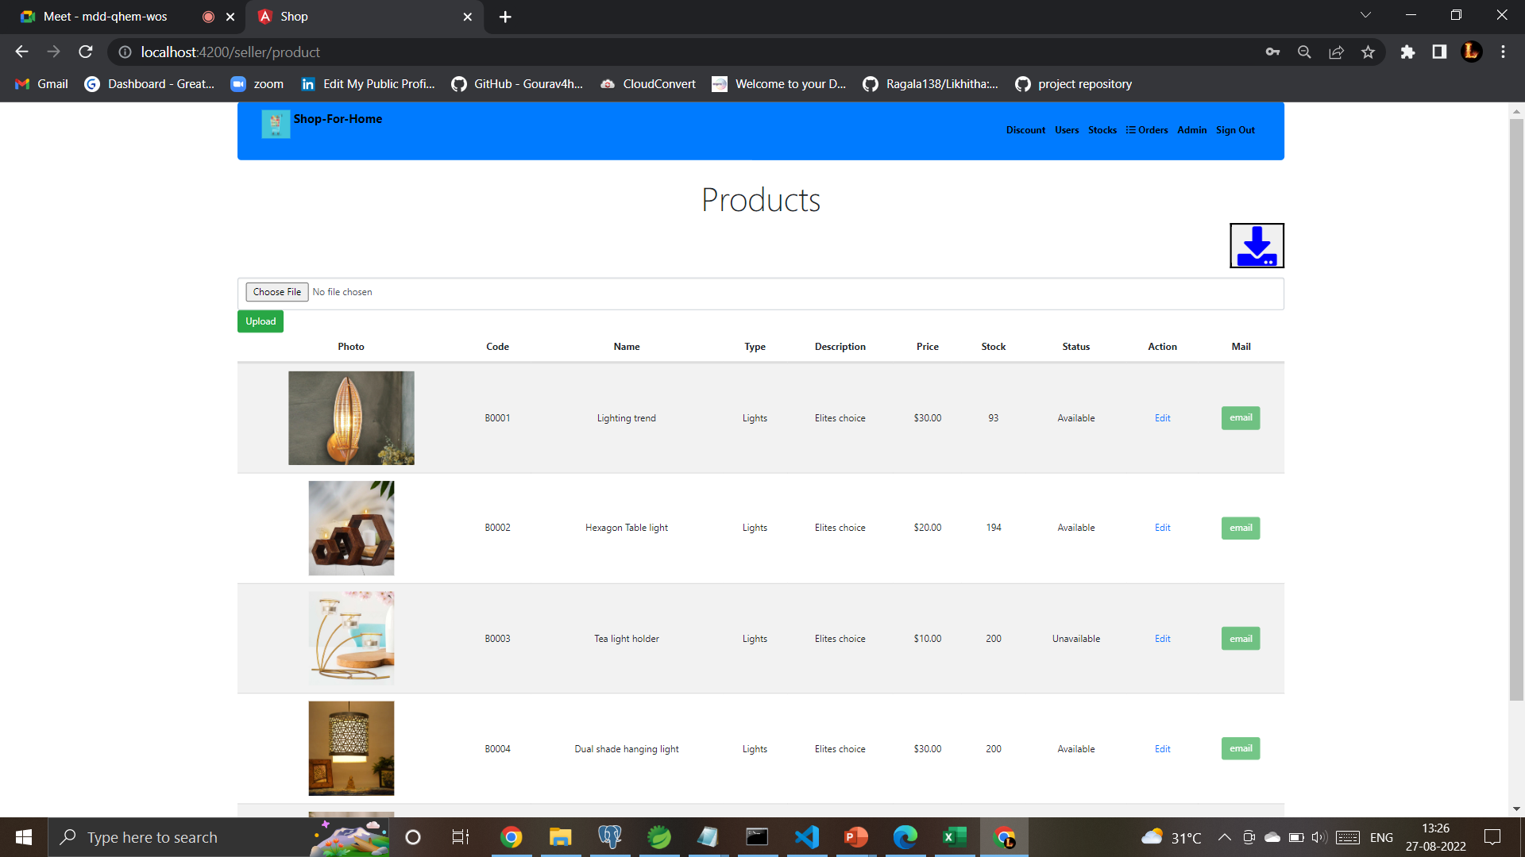
Admin Products

Slide 13
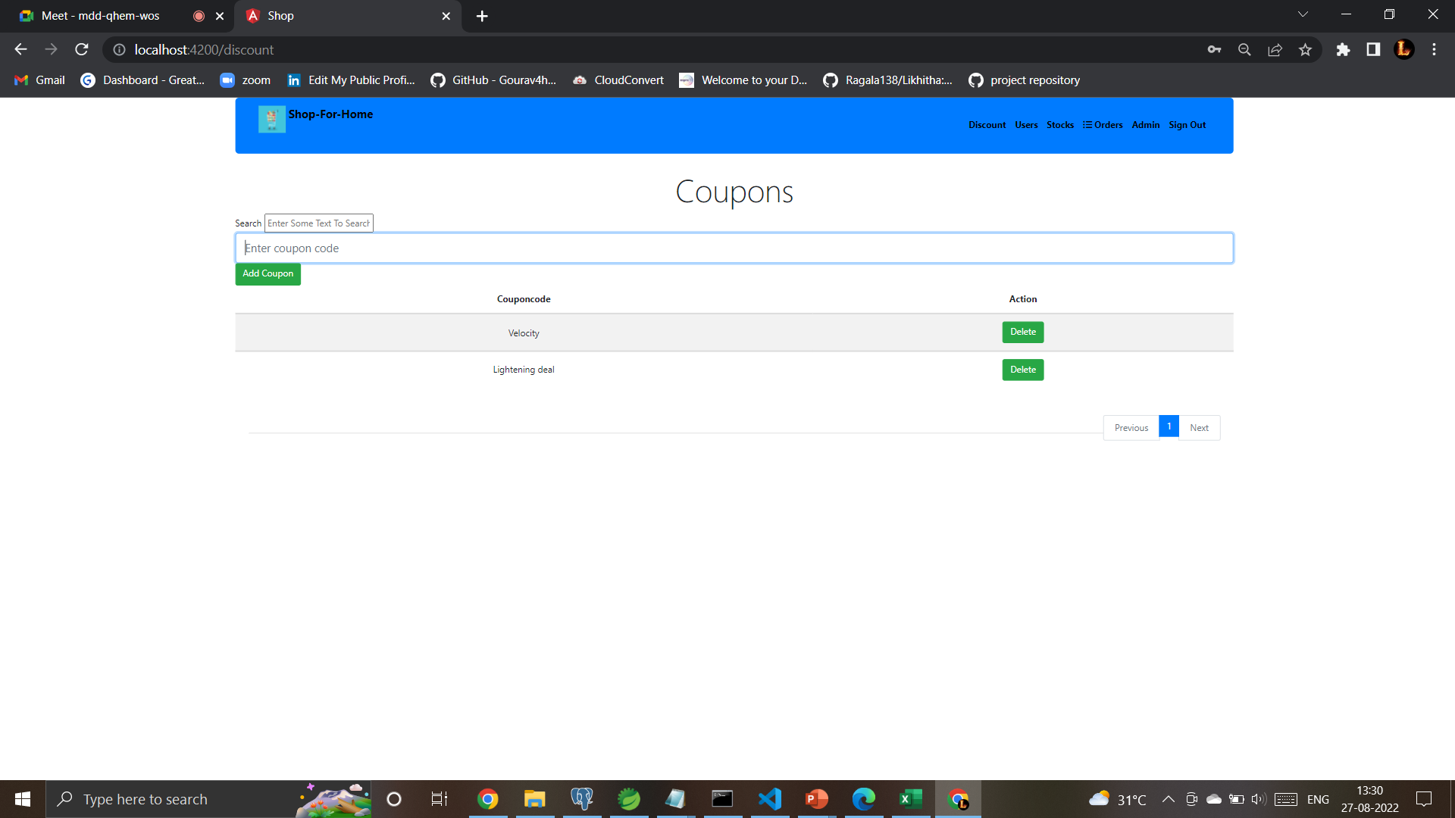
discount

Slide 14
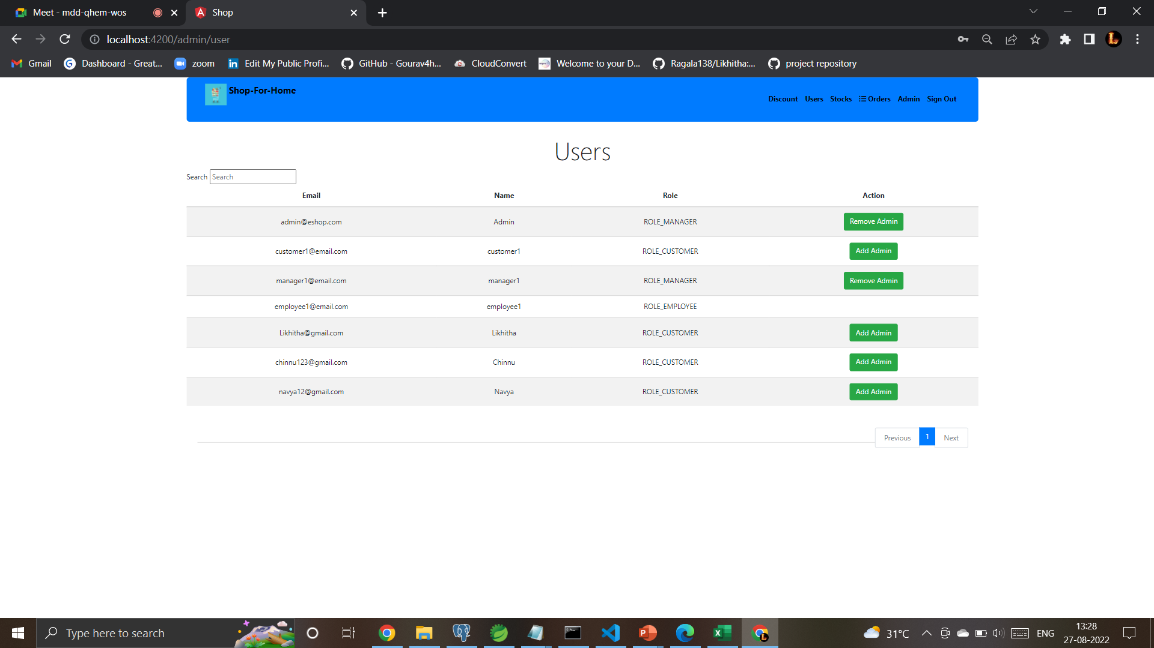
Admin user

Slide 15
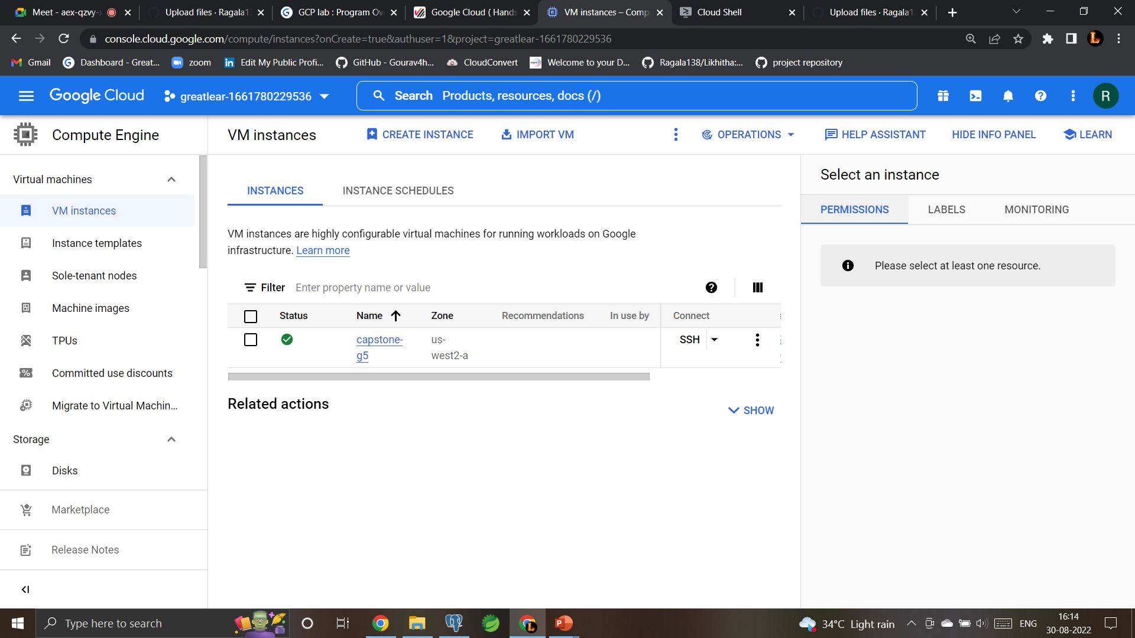

Slide 16
Cloud deploy

Slide 18
Conclusion
ShopFor Home is a user friendly web Application made for ShopForHome Store. User Can Search For Product ,Add the product in to the cart ,Add the product in to wishlist easily.
Despite of covid of Covid19 this web application can be used to run a business online successfully

Slide 19


